Slide 1



Slide 2
Agenda
INTRODUCTION
LOGIN OR SIGNUP
MAIN CODE
SCORE-BOARD
FINAL CODE AND OUTPUT

Slide 3

Introduction
It is a quiz, consisting of 3 categories. Namely python, sports and social. The user needs to login or signup to get access to the quiz. Select a category of your choice then the questions with options will be displayed. Give your answers. Finally at the end the score-board will be displayed each time. You can compare your score with the other users.

Slide 4
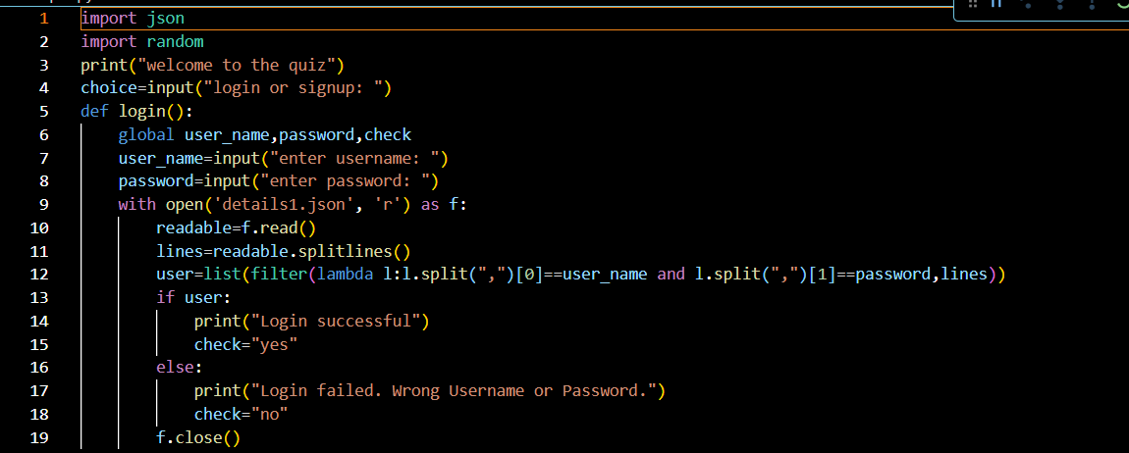
LOGIN OR SIGNUP

Slide 5
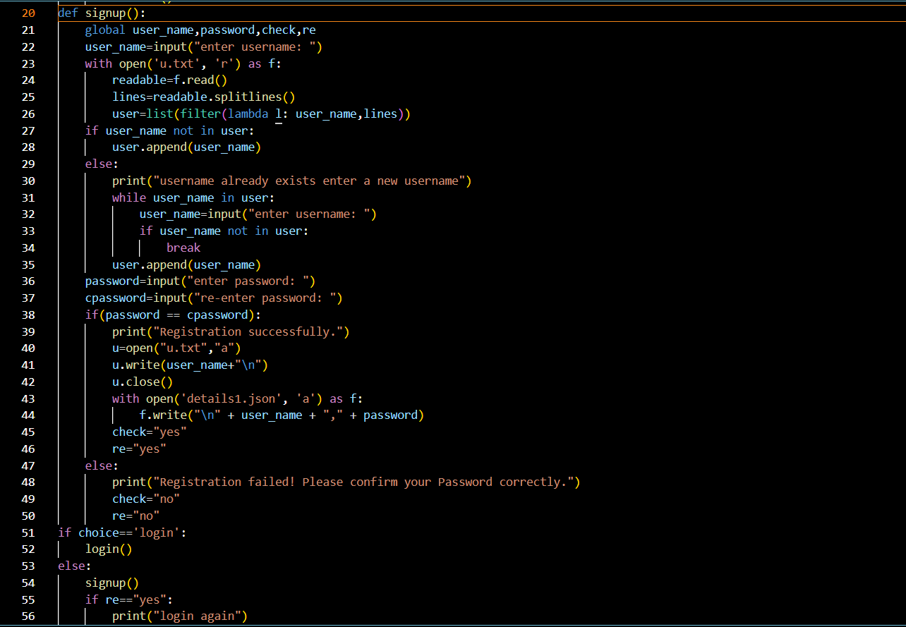

Slide 6
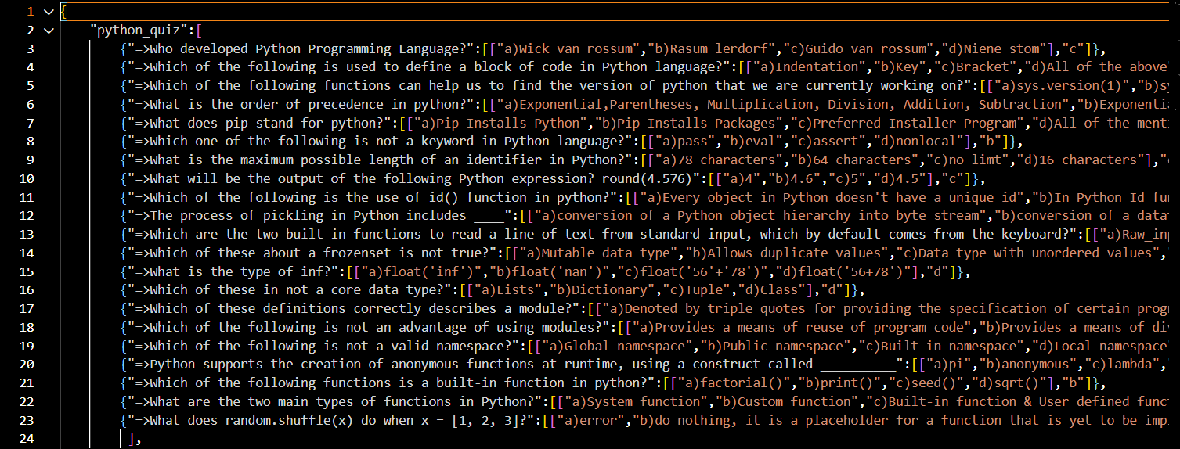
In this part of code , we import json and random modules. We use a json file to store questions of the quiz of different categories. So, we created a quiz_questions. json and stored questions belongs to different categories like python_quiz, sports_quiz, social_quiz. load() function is used to convert a json file to a dictionary. User can choose his own choice in category. Using for-loop, the questions are printed. We use random functions to get a random question from the given dictionary and store it in a variable. Now remove this questions from the dictionary so that the questions are not repeated. We can access this question using variable. Question is printed and using for loop print the options too. Now the user should give the correct option. If the user give the options other than (a/b/c/d) then the user is asked to enter a valid option. If the answer entered by the user is correct then 1 is added to score.

Slide 7
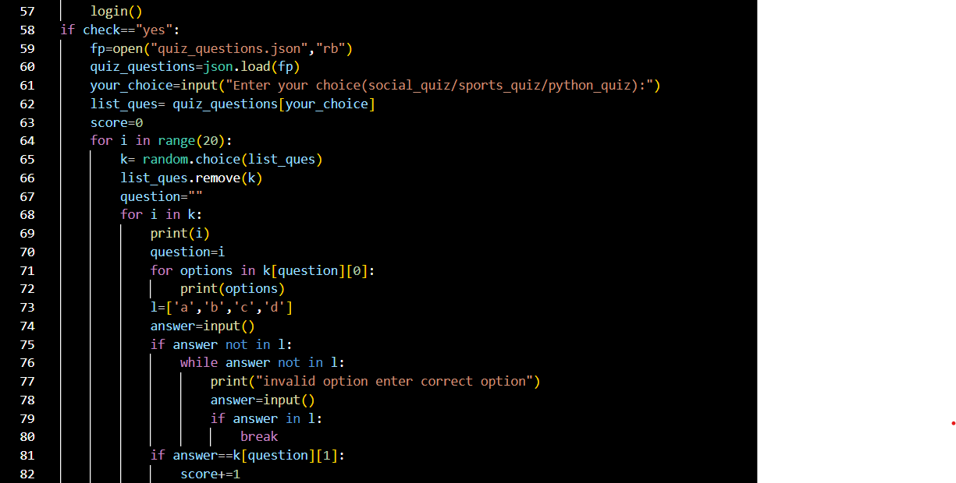

Slide 8
SCORE-BOARD
For the category which we have selected of our choice, the scores which we get are appended into a text file of that category. If we select python quiz, then the scores which we get are appended to the text file python_score.txt. For choosing social _quiz, the scores are appended to the text file social_score.txt. If we choose sports_quiz, the scores are appended to the text file sports_score.txt. The scores we get in these categories are saved each time play and they can be compared with other player's scores.

Slide 9
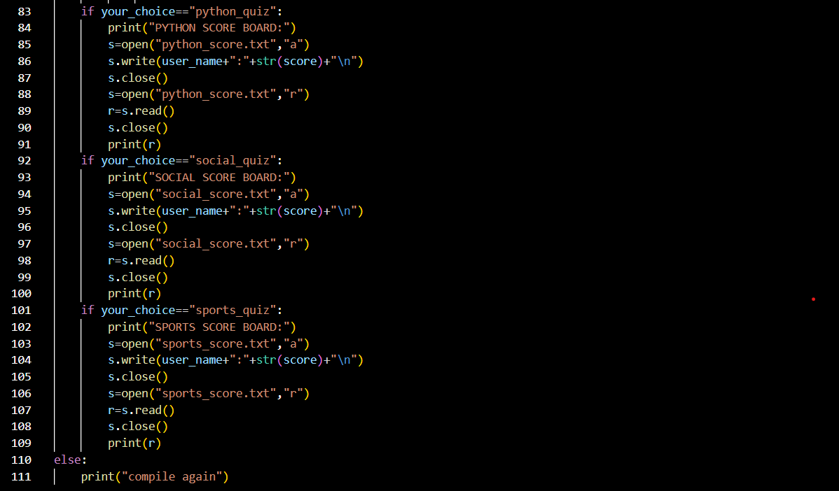

Slide 10
thank you
Sharvani- 22BD1A6727
Sreeja- 22BD1A6728
Pavitra- 22BD1A6717

